Slide 1
Support Kusto Query Language natively in ClickHouse
March 9 , 2023

Slide 2
Contents
Update from December, 2022 to Feb 28 , 2023
Upcoming features for March 18, 2023
All implemented features

Slide 3
Update from December, 2022 to Feb 28 , 2023
New features :
3 operators : top-nested, range, project-away
36 functions : mathematic, aggregation
1 IBM-KQL Custom Function: lookup
4 case insensitive operators : in~ , !in~ , =~ , !~
Bug fix and improvement
19 bugs fixed

Slide 4
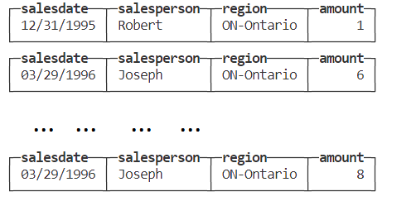
Operator : top-nested
top-nested operator can be used to answer the following question: For a table containing sales figures, such as : region, salesperson, amount sold
What are the top 3 regions by sales?
What are the top 2 salespeople in each of these regions?
What are top 3 and other regions by sales and top 2 and other salespeople in each of these regions?

Slide 5
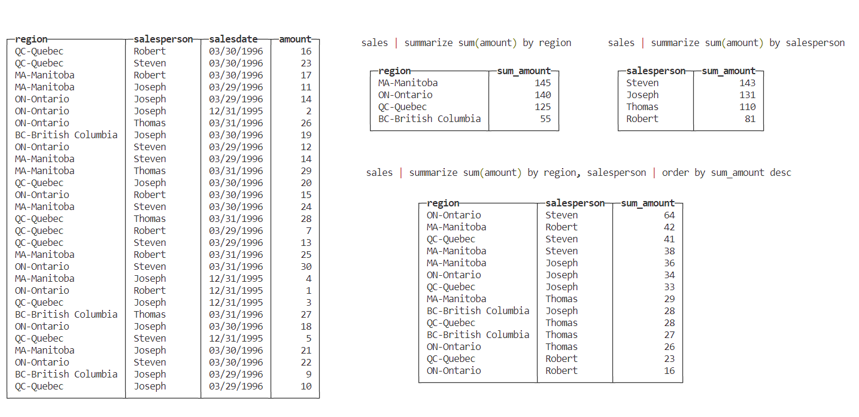
Sales table

Slide 6
Top 3 regions by sales
sales | top-nested 3 of region by sum(amount)
┌─region──────┬─aggregated_region─┐
│ MA-Manitoba │ 145 │
│ ON-Ontario │ 140 │
│ QC-Quebec │ 125 │
└─────────────┴───────────────────┘

Slide 7
Top 2 salespeople in each of these regions
sales | top-nested 3 of region by sum(amount), top-nested 2 of salesperson by sum(amount);
┌─region──────┬─aggregated_region─┬─salesperson─┬─aggregated_salesperson─┐
│ MA-Manitoba │ 145 │ Robert │ 42 │
│ MA-Manitoba │ 145 │ Steven │ 38 │
│ ON-Ontario │ 140 │ Steven │ 64 │
│ ON-Ontario │ 140 │ Joseph │ 34 │
│ QC-Quebec │ 125 │ Steven │ 41 │
│ QC-Quebec │ 125 │ Joseph │ 33 │
└─────────────┴───────────────────┴─────────────┴────────────────────────┘

Slide 8
Top 3 and other regions by sales and top 2 and other salespeople in each of these regions
sales | top-nested 3 of region with others = 'all other region' by sum(amount), top-nested 2 of salesperson by sum(amount)
┌─region──────┬─aggregated_region─┬─salesperson─┬─aggregated_salesperson─┐
│ MA-Manitoba │ 145 │ Robert │ 42 │
│ MA-Manitoba │ 145 │ Steven │ 38 │
│ ON-Ontario │ 140 │ Steven │ 64 │
│ ON-Ontario │ 140 │ Joseph │ 34 │
│ QC-Quebec │ 125 │ Steven │ 41 │
│ QC-Quebec │ 125 │ Joseph │ 33 │
└─────────────┴───────────────────┴─────────────┴────────────────────────┘
┌─region──────┬─aggregated_region─┬─salesperson──────┬─aggregated_salesperson─┐
│ QC-Quebec │ 125 │ all other person │ 51 │
│ ON-Ontario │ 140 │ all other person │ 42 │
│ MA-Manitoba │ 145 │ all other person │ 65 │
└─────────────┴───────────────────┴──────────────────┴────────────────────────┘
┌─region───────────┬─aggregated_region─┬─salesperson──────┬─aggregated_salesperson─┐
│ all other region │ 55 │ all other person │ 55 │
└──────────────────┴───────────────────┴──────────────────┴────────────────────────┘

Slide 9
Operator : range
Return a table with a single column
range LastWeek from ago(7d) to now() step 1d range Steps from 1 to 8 step 3
┌──────────────────────LastWeek─┐ ┌─Steps─┐
│ 2023-03-01 06:51:49.972387845 │ │ 1 │
│ 2023-03-02 06:51:49.972387845 │ │ 4 │
│ 2023-03-03 06:51:49.972387845 │ │ 7 │
│ 2023-03-04 06:51:49.972387845 │ └───────┘
│ 2023-03-05 06:51:49.972387845 │
│ 2023-03-06 06:51:49.972387845 │
│ 2023-03-07 06:51:49.972387845 │
│ 2023-03-08 06:51:49.972387845 │
└───────────────────────────────┘

Slide 10
Operator : project-away
T | project-away ColumnNameOrPattern
┌─FirstName─┬─LastName─┬─Occupation───────────┬─Education─┬─Age─┐
│ Theodore │ Diaz │ Skilled Manual │ Bachelors │ 28 │
│ Stephanie │ Cox │ Management abcd defg │ Bachelors │ 33 │
└───────────┴──────────┴──────────────────────┴───────────┴─────┘
Customers | project-away FirstName
┌─LastName─┬─Occupation───────────┬─Education─┬─Age─┐
│ Diaz │ Skilled Manual │ Bachelors │ 28 │
│ Cox │ Management abcd defg │ Bachelors │ 33 │
└──────────┴──────────────────────┴───────────┴─────┘
Customers | project-away *Name
┌─Occupation───────────┬─Education─┬─Age─┐
│ Skilled Manual │ Bachelors │ 28 │
│ Management abcd defg │ Bachelors │ 33 │
└──────────────────────┴───────────┴─────┘

Slide 11
Functions:
Mathematical functions
abs, acos, asin, atan, atan2, ceiling, cos, cot, degrees,
exp, exp2, exp10, gamma, isfinite, isinf, log, log2,
log10, loggamma, max_of, min_of, pi, pow, radians,
rand, round, sign, sin, sqrt, tan
Aggregate functions:
take_any , take_anyif , variance , variancep , varianceif
Other functions:
range(), lookup()

Slide 12
lookup() function
Requirements:
IBM-KQL Custom Function: lookup
Map calls directly to dictGet(), dictGetOrDefault() depending on parameters
Be able to be used in | project, or anywhere else a KQL function call is allowed to be used.

Slide 13
Lookup()
DROP TABLE IF EXISTS dictionary_source_table;
CREATE TABLE dictionary_source_table
(
key String,
start_range UInt64,
end_range UInt64,
value String,
value_nullable Nullable(String)
)
ENGINE = Memory;
INSERT INTO dictionary_source_table VALUES('1', 10, 20, 'First', 'First'), ('2', 11, 21, 'Second', NULL), ('3', 12, 22, 'Third', 'Third');

Slide 14
Lookup()
CREATE DICTIONARY dictionary_table
(
key String,
start_range UInt64,
end_range UInt64,
value String,
value_nullable Nullable(String)
)
PRIMARY KEY key
SOURCE(CLICKHOUSE(HOST 'localhost' PORT tcpPort() TABLE 'dictionary_source_table'))
LIFETIME(MIN 1 MAX 1000)
LAYOUT(FLAT());

Slide 15
Lookup()
print lookup('dictionary_table', 'value', '1');
SELECT dictGet('dictionary_table', 'value', '1') AS print_0
Query id: 05799f3a-589f-4249-98a3-6d4210bd0717
┌─print_0─┐
│ First │
└─────────┘

Slide 16
Improvement
dcount() and dcountif()
docunt and dcountif now accept the additional accuracy parameter which is the base-2 logarithm of the number of cells in HyperLogLog.
Multiple columns in sub-query.
Multiple columns in sub-query works in KQL ADX but only the first column is effective, while not working in ClickHouse. this fixed issue. e.g.
Customers | where FirstName in ((Customers2|project FirstName, LastName))

Slide 17
Upcoming features for March 18, 2023.
Operator
getschema (done)
default alias for print operator (done)
Functions:
Already done:
has_ipv4() , has_any_ipv4() , has_ipv4_prefix() , has_any_ipv4_prefix()
string_size() , to_utf8() , new_guid()
between, !between, not
Work in progess:
toscalar, make_string, gettype, indexof_regex
has_ipv6,has_any_ipv6,has_ipv6_prefix ,has_any_ipv6_prefix

Slide 18
getschema
CREATE TABLE Customers
(
FirstName Nullable(String),
LastName String,
Occupation String,
Education String,
Age Nullable(UInt8)
) ENGINE = Memory;

Slide 19
getschema - table
Customers|getschema
┌─ColumnName─┬─ColumnOrdinal─┬─DataType─────────┬─ColumnType─┐
│ FirstName │ 0 │ Nullable(String) │ string │
│ LastName │ 1 │ String │ string │
│ Occupation │ 2 │ String │ string │
│ Education │ 3 │ String │ string │
│ Age │ 4 │ Nullable(UInt8) │ int │
└────────────┴───────────────┴──────────────────┴────────────┘
Customers|getschema | where DataType contains 'String’
┌─ColumnName─┬─ColumnOrdinal─┬─DataType─────────┬─ColumnType─┐
│ FirstName │ 0 │ Nullable(String) │ string │
│ LastName │ 1 │ String │ string │
│ Occupation │ 2 │ String │ string │
│ Education │ 3 │ String │ string │
└────────────┴───────────────┴──────────────────┴────────────┘

Slide 20
getschema - query
Customers|summarize avg(Age) by FirstName|getschema
┌─ColumnName─┬─ColumnOrdinal─┬─DataType──────────┬─ColumnType─┐
│ FirstName │ 0 │ Nullable(String) │ string │
│ avg_Age │ 1 │ Nullable(Float64) │ real │
└────────────┴───────────────┴───────────────────┴────────────┘
select * from kql(Customers|getschema|where DataType has "String")
┌─ColumnName─┬─ColumnOrdinal─┬─DataType─────────┬─ColumnType─┐
│ FirstName │ 0 │ Nullable(String) │ string │
│ LastName │ 1 │ String │ string │
│ Occupation │ 2 │ String │ string │
│ Education │ 3 │ String │ string │
└────────────┴───────────────┴──────────────────┴────────────┘

Slide 21
Default alias of print operator
print format_ipv4_mask('1.1.1.1’)
before
┌─if(or(empty(ifNull(if(or(and(isNotNull(toUInt32OrNull(toString('1.1.1.1'))), equals(toTypeName('1.1.1.1'), 'String')), less(32, 0), isNull(ifNull(toUInt32OrNull(toString('1.1.1.1')), multiIf(equals(length(splitByChar('/', ifNull(kql_tostring('1.1.1.1'), ''))), 1), IPv4StringToNumOrNull(arrayElement(splitByChar('/', ifNull(kql_tostring('1.1.1.1'), '')), 1)), and(equals(length(splitByChar('/', ifNull(kql_tostring('1.1.1.1'), ''))), 2), isNotNull(IPv4StringToNumOrNull(arrayElement(splitByChar('/', ifNull(kql_tostring('1.1.1.1'), '')), 1))), isNotNull(toUInt8OrNull(arrayElement(splitByChar('/', ifNull(kql_tostring('1.1.1.1'), '')), -1)))), tupleElement(IPv4CIDRToRange(assumeNotNull(IPv4StringToNumOrNull(arrayElement(splitByChar('/', ifNull(kql_tostring('1.1.1.1'), '')), 1))), assumeNotNull(toUInt8OrNull(arrayElement(splitByChar('/', ifNull(kql_tostring('1.1.1.1'), '')), -1)))), 1), NULL)))), NULL, IPv4NumToString(bitAnd(ifNull(toUInt32OrNull(toString('1.1.1.1')), multiIf(equals(length(splitByChar('/', ifNull(kql_tostring('1.1.1.1'), ''))), 1), IPv4StringToNumOrNull(arrayElement(splitByChar('/', ifNull(kql_tostring('1.1.1.1'), '')), 1)), and(equals(length(splitByChar('/', ifNull(kql_tostring('1.1.1.1'), ''))), 2), isNotNull(IPv4StringToNumOrNull(arrayElement(splitByChar('/', ifNull(kql_tostring('1.1.1.1'), '')), 1))), isNotNull(toUInt8OrNull(arrayElement(splitByChar('/', ifNull(kql_tostring('1.1.1.1'), '')), -1)))), tupleElement(IPv4CIDRToRange(assumeNotNull(IPv4StringToNumOrNull(arrayElement(splitByChar('/', ifNull(kql_tostring('1.1.1.1'), '')), 1))), assumeNotNull(toUInt8OrNull(arrayElement(splitByChar('/', ifNull(kql_tostring('1.1.1.1'), '')), -1)))), 1), NULL)), bitNot(toUInt32(minus(intExp2(minus(32, 32)), 1)))))), '')), equals(position(toTypeName(32), 'Int'), 0), not(and(greaterOrEquals(32, 0), lessOrEquals(32, 32)))), '', concat(ifNull(if(or(and(isNotNull(toUInt32OrNull(toString('1.1.1.1'))), equals(toTypeName('1.1.1.1'), 'String')), less(32, 0), isNull(ifNull(toUInt32OrNull(toString('1.1.1.1')), multiIf(equals(length(splitByChar('/', ifNull(kql_tostring('1.1.1.1'), ''))), 1), IPv4StringToNumOrNull(arrayElement(splitByChar('/', ifNull(kql_tostring('1.1.1.1'), '')), 1)), and(equals(length(splitByChar('/', ifNull(kql_tostring('1.1.1.1'), ''))), 2), isNotNull(IPv4StringToNumOrNull(arrayElement(splitByChar('/', ifNull(kql_tostring('1.1.1.1'), '')), 1))), isNotNull(toUInt8OrNull(arrayElement(splitByChar('/', ifNull(kql_tostring('1.1.1.1'), '')), -1)))), tupleElement(IPv4CIDRToRange(assumeNotNull(IPv4StringToNumOrNull(arrayElement(splitByChar('/', ifNull(kql_tostring('1.1.1.1'), '')), 1))), assumeNotNull(toUInt8OrNull(arrayElement(splitByChar('/', ifNull(kql_tostring('1.1.1.1'), '')), -1)))), 1), NULL)))), NULL, IPv4NumToString(bitAnd(ifNull(toUInt32OrNull(toString('1.1.1.1')), multiIf(equals(length(splitByChar('/', ifNull(kql_tostring('1.1.1.1'), ''))), 1), IPv4StringToNumOrNull(arrayElement(splitByChar('/', ifNull(kql_tostring('1.1.1.1'), '')), 1)), and(equals(length(splitByChar('/', ifNull(kql_tostring('1.1.1.1'), ''))), 2), isNotNull(IPv4StringToNumOrNull(arrayElement(splitByChar('/', ifNull(kql_tostring('1.1.1.1'), '')), 1))), isNotNull(toUInt8OrNull(arrayElement(splitByChar('/', ifNull(kql_tostring('1.1.1.1'), '')), -1)))), tupleElement(IPv4CIDRToRange(assumeNotNull(IPv4StringToNumOrNull(arrayElement(splitByChar('/', ifNull(kql_tostring('1.1.1.1'), '')), 1))), assumeNotNull(toUInt8OrNull(arrayElement(splitByChar('/', ifNull(kql_tostring('1.1.1.1'), '')), -1)))), 1), NULL)), bitNot(toUInt32(minus(intExp2(minus(32, 32)), 1)))))), ''), '/', toString(toInt64(min2(32, ifNull(multiIf(or(greater(length(splitByChar('/', ifNull(kql_tostring('1.1.1.1'), ''))), 2), not(isIPv4String(arrayElement(splitByChar('/', ifNull(kql_tostring('1.1.1.1'), '')), 1)))), NULL, equals(length(splitByChar('/', ifNull(kql_tostring('1.1.1.1'), ''))), 1), 32, isNull(toUInt8OrNull(arrayElement(splitByChar('/', ifNull(kql_tostring('1.1.1.1'), '')), -1))), NULL, toUInt8(min2(toUInt8OrNull(arrayElement(splitByChar('/', ifNull(kql_tostring('1.1.1.1'), '')), -1)), 32))), 32))))))─┐
│ 1.1.1.1/32 │
└────────────────────────────────────────────────────────────────────────────────────────────────────────────────────────────────────────────────────────────────────────────────────────────────────────────────────────────────────────────────────────────┘
after
┌─print_0────┐
│ 1.1.1.1/32 │
└────────────┘

Slide 22
All available KQL features:
https://github.ibm.com/ClickHouse/issue-repo/blob/master/docs/features/KQL/IBM_KQL_Support_ClickHouse.md

